Slide 1
Life Cycle Cost Trade-off Model: Comparison of Life Expectancy and Quality on Overall Cost
Connor Jennings and Janis Terpenny

Slide 2
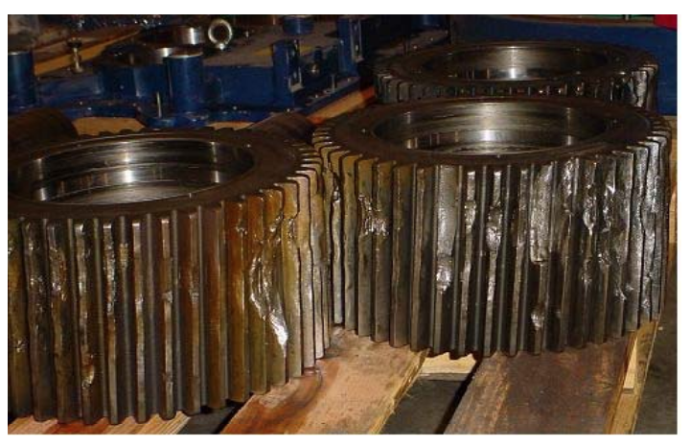
Types of Wear Predictions
Health Status Monitoring
Failure Forecasting
Life-Cycle Estimations

Slide 3
Research Questions
Questions on Tradeoff Between Life-Cycle Cost and Life-Cycle Length
Q1. How can a generalizable machine learning framework be created to estimate the life cycle and cost of a product given usage, material properties and general cost information?
Q2. What is required in order to optimize the general machine learning framework presented in Q1?

Slide 4
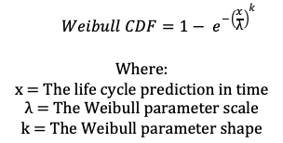
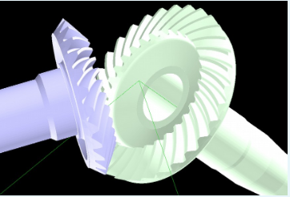
Life cycle Cost Tradeoff Case Study
Life Cycle Model
Physics-based Simulation
Run time: 5-20 hours

Slide 5
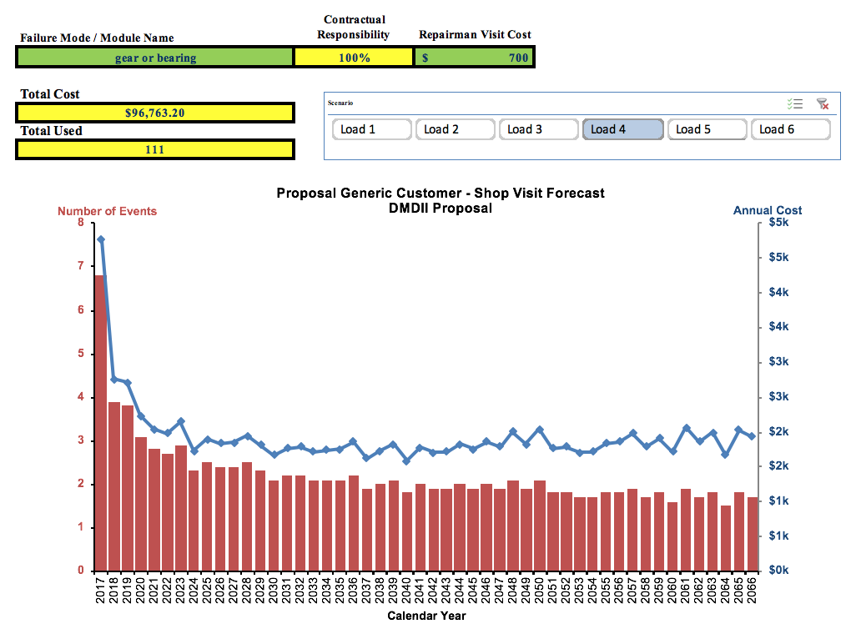
Life cycle Cost Tradeoff Case Study
Life Cycle Cost Model
Excel Monte Carlo Simulation
Run time: 5-10 minutes

Slide 6
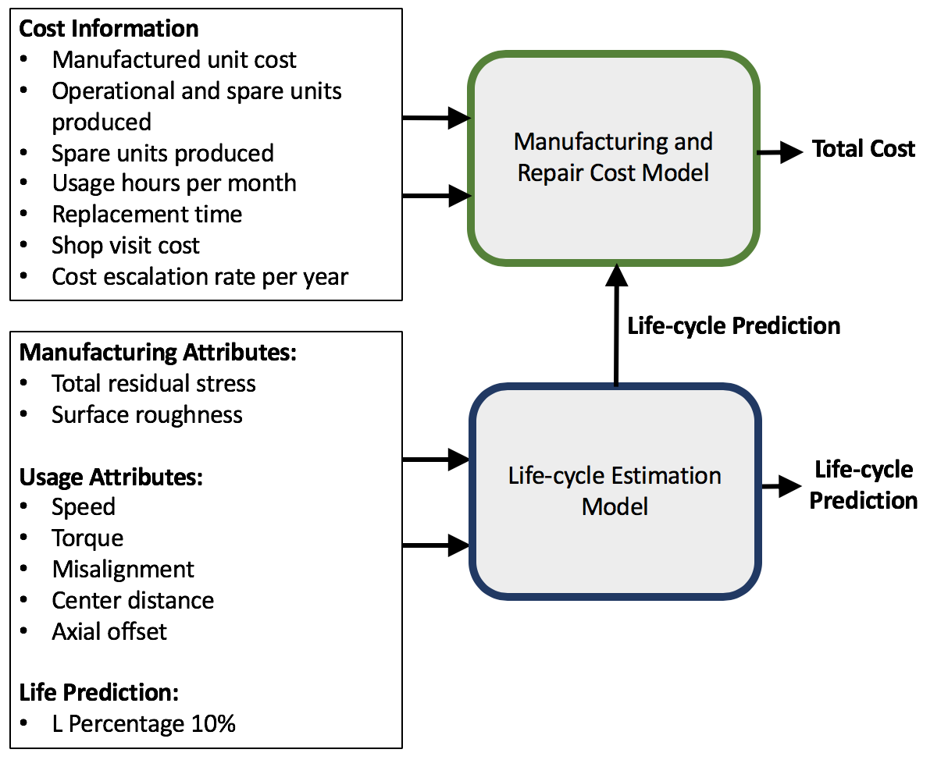
Information Flow For Each Model

Slide 7
Fitting machine learning model
Excel and physics-based simulation were slow (5-20 hours)
Life Cycle Model
Generated 400 instances
Fit a 10 node single layer neural network model to capture relationship
Life Cycle Cost Model
Generated 120 instances
Fit a 10 node single layer neural network model to capture relationship
Machine learning model predictions in under a second

Slide 8
What can we do with faster predictions?

Slide 9
Life cycle & Cost Optimization Configurations
Minimize cost while maintaining a minimum life cycle
Maximizing life cycle while maintaining a maximum cost

Slide 10
Genetic Search Algorithm - General
Evaluation
Selection
Mutation
Crossover

Slide 11
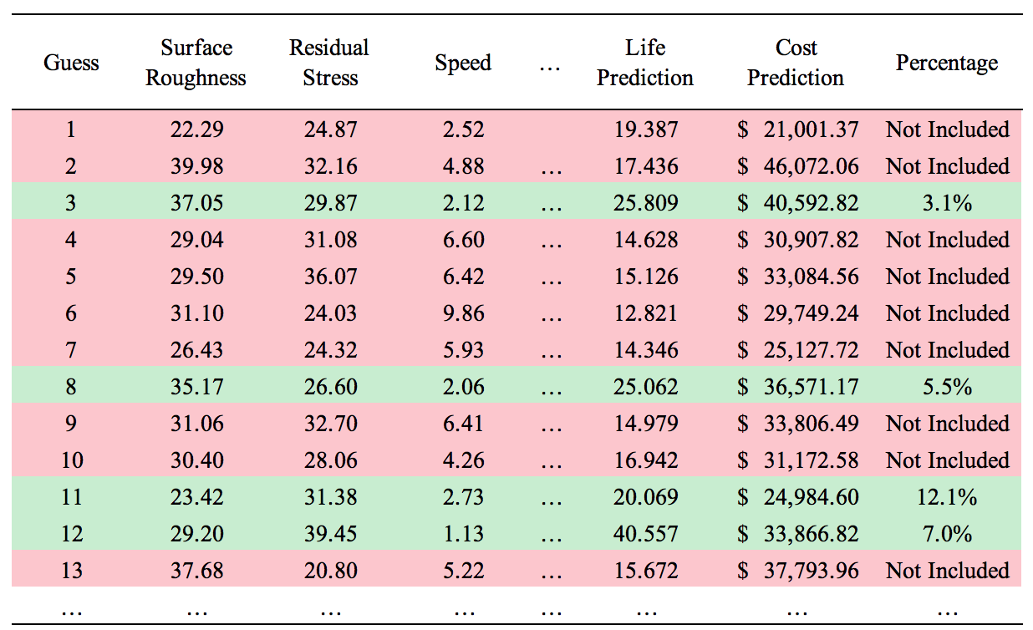
Genetic Search Algorithm – Life & Cost

Slide 12
Genetic Algorithm Setting Up
5000 guess per generation
150 generations
Returned the top 25 best values for the objective value that meet the constraint

Slide 13
Genetic Search Algorithm Goal: Minimize cost for a life of 20 Cost and Life Cycle of each generation over 150 iterations

Slide 14
Life Cycle vs. Cost Tradeoff Optimizing for Minimum Cost with a Life Cycle of 20
Average green and blue values:
Cost of $78,253.58 and life cycle of 22.5
Average blue values:
Cost of $24,438.79 and life cycle of 21.4
68.8% drop in cost between possible solutions and returned

Slide 15
Genetic Search Algorithm Goal: Maximize life cost for a
cost of $80,000 Cost and Life Cycle of each generation over 150 iterations

Slide 16
Life Cycle vs. Cost Tradeoff Optimizing for Maximum Life Cycle with a Cost of $80,000
Average green and blue values:
Cost of $61,193.55 and life cycle of 21.6
Average blue values:
Cost of $67,394.75 and life cycle of 24.7
14.4% increase in life cycle between possible solutions and returned

Slide 17
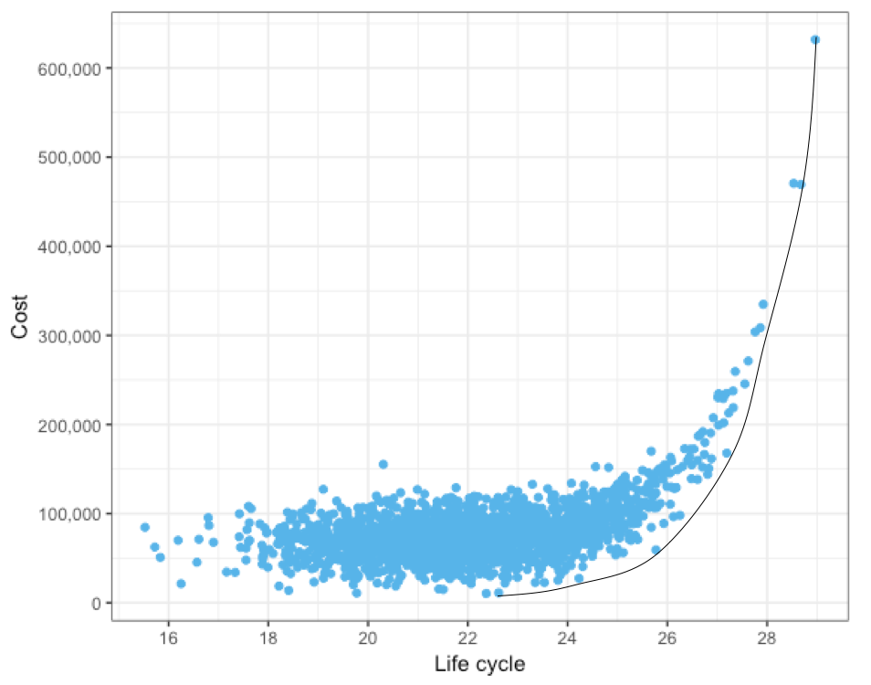
Pareto Frontier of Solutions

Slide 18
Conclusions
Genetic optimization can be used to help tradeoff between life cycle and cost
Returning a subset of solutions improve the alternatives for users
The resulting solutions form a pareto frontier of alternatives

Slide 19
Future Work
Further investigate pareto frontier of solutions and the potential impacts the frontier could have in finding optimal solutions
Account for the underlying distribution of life cycle and cost predictions to not only optimize cost and life cycle, but variance too
Develop method to help users to select optimal solutions from top possibilities.

Slide 20
Acknowledgements
This work was funded by DMDII project #15-05-03.

Slide 21
Questions

